Slide 1
Smart India Hackathon 2018
Government of Delhi
Problem Statement: #GDL 26
To develop Feedback system with update, edit, questionnaire, possibility
with a rating system.
<number>

Slide 2
GROUP MEMBERS:
Ayush Mohan Das (Team Leader)
Kunal Sharma
Malika Gupta
Shruti Dhakarwal
Amitesh Agrahari
Suryansh Udit
<number>

Slide 3
POINTS TO BE DISCUSS
INTRODUCTION
PROJECT ANALYSIS
SOFTWARE & HARDWARE REQUIREMENTS
PLANNING AND SCHEDULING
PROJECT PATH WAY
PROJECT DESIGN
USER CASE DIAGRAMS
LOGIN PORTALS
REGISTRATION PORTAL
DEVELOPING MODEL
PROJECT TESTING
CONCLUSION & ENHANCEMENTS
REFERENCE’s
<number>

Slide 4
Introduction
So we call it as Student Feedback System which delivers via the student staff interface as online system which acting as a Service Provider.
We have developed Student Feedback System to provide feedback in an easy and quick manner to the college principal.
By using this technology we can make fast feedback about the staff by students on time to head of departments as they referred in online system.
This project has two kinds of modules Student and Admin. The student can give feedback in online system provided by college staff.
This feedback report is checked by the Admin.
He can view grades and view the grades obtained to the lecturers and give this report to the principal and he give counseling to the college staff.
<number>

Slide 5

SOFTWARE AND HARDWARE RQUIREMENTS
Hardware Requirements
Processor: Pentium pro,Intel i7,i5,i3
Primary Memory: 256 MB RAM.
Hard Disk: 2GB(min.)
Software Requirements
Language used: Php, CSS , HTML , js and bootstrap.
Platform : Windows 7/8/XP/10
Tools used: Internet explorer, Mozilla Firefox, Chrome.
<number>

Slide 6
PLANNING AND SECHEDULE
Planning of project requires dividing of various project phases into a defined time scale for completion of project on time. planning and scheduling are very crucial phase of project life cycle because the project successful depends on this. a high or low time estimation of the projects leads to large variation in project overall cost estimates.
<number>

Slide 7
Project Path Way
We have divided our project in Five modules,to reduce time and cost of process.Then these five modules will be integrated in one system.
MODULE 1: It generally dealswith gathering information about the project.
MODULE 2: Planning about how to start with the project.Initial phases Student ,Admin ,Faculty Interfaces.
MODULE 3: It dealswith the architecture of our project and Challenges which has to be overcome successfully.
MODULE 4:It deals with calculating result using required logic via using developing model.
MODULE 5:At last the testing of project with proposed system .
<number>

Slide 8
PROJECT DESIGN
Software design is an interactive process through which requirements are translated into a ‘Blue Print’ for constructing the software. The design is represented at high level of abstraction, a level that can be directly translated to specific data, functional and behavioral requirements.
Preliminary design is concerned with the transformation of requirements into data and software architecture. Detailed design focuses on refinements to the architectural representation that lead to detailed data structure and algorithmic representation for software.
Design View
a)Technology Stack
b)Registration Portal (USE CASE)
c)Login Portal
9

Slide 9
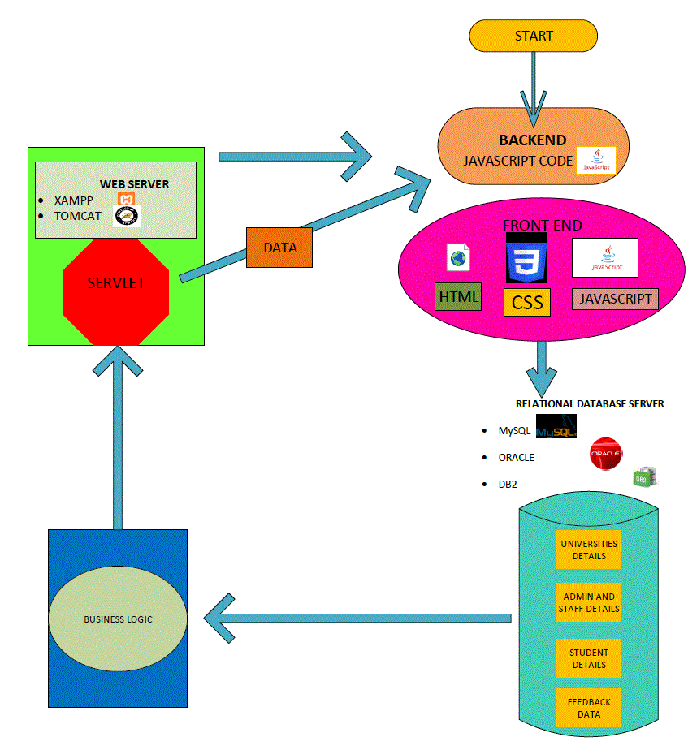
Logout
12
ER DIAGRAM

Slide 10
Logout
12
ER DIAGRAM

Slide 12
Developing Model
Rapid application development (RAD) is both a general term used to refer to alternatives to the conventional waterfall model of software development as well as the name for James Martin's approach to rapid development. In general, RAD approaches to software development put less emphasis on planning tasks and more emphasis on development. In contrast to the waterfall model, which emphasizes rigorous specification and planning, RAD approaches emphasize the necessity of adjusting requirements in reaction to knowledge gained as the project progresses.
This causes RAD to use prototypes in addition to or even sometimes in place of design specifications.
RAD approaches rigorously defining specifications emphasize a flexible process that can adapt as the project evolves rather than the plans correctly from the start.
<number>

Slide 13
Testing Strategies
Software testing is a critical element of software quality assurance and represents the ultimate reuse of specification. Design and code testing represents interesting anomaly for the software during earlier definition and development phase, it was attempted to build software from an abstract concept to tangible implementation.
The testing phase involves, testing of the development of the system using certain tools.
A strategy for software testing must accommodate low-level tests that are necessary to verify that a small source code segment has been correctly implemented as well as high level against customer requirements.
<number>

Slide 14
Unit Testing::
Unit testing focuses verification on the smaller unit of software design such as form. This is known as form testing.
Integration Testing:
Data can be lost across an interface, one module can have an adverse effect on another sub function, when combined, may not produce the desired major function.
System Testing:
Testing the entire system as a whole and checking for its correctness is system testing. The system is listed for dispensaries between the system and its original objectives. This project was effective and efficient.
<number>

Slide 15

Conclusion and Enhancements
Conclusion :
The Project “Student Feedback System” is designed in order reduce the burden of maintaining bulk of records of all the students feedback details of who study in an Educational Institution. Inserting, retrieving and updating the feedback details of a student are easy when it is compared to the manual feedback and storing. Maintaining the project is also easy which can is easily understandable. Maintaining the details in the database is manageable. By using this technology of online system, feedback is obtained efficiently and quickly as compared to the existing pen-paper feedback system.
Future Enhancements :
Due to the lack of time, the design part is not done so attractive. Further enhancements can be made in designing the screens. Some more forms can also be added so as to better retrieve the feedback details. Various other options can also be added for the better usability of project, Their will be privacy and security of the feedbacks provided by the students to
the teacher concerned.
<number>

Slide 16

19

